Slide 1
Job Shop Scheduling (with “Flow Shop” special case)
ISE 419

Slide 2
Job Shop Scheduling
Have m machines and n jobs
Each job visits some or all of the machines
each job follows a predetermined route
routes are not necessarily the same for each job
machine can be visited once or more than once (recirculation)
Customer order of small batches
Wafer fabrication in semiconductor industry
Hospital
Very difficult to solve

Slide 3
Machine Configurations
Flow Shop
Job Shop

Slide 4
Machine characteristics
Open shop O_{m}
m machines
each job has to be processed on each of the m machines
scheduler determines the route for each job
Job shop J_{m}
m machines
each job has its own route
job may visit a machine more then once (recirculation) Fm | recrc | ...

Slide 5
General Solution Techniques
Mathematical programming
Linear, non-linear, and integer programming
Enumerative methods
Branch-and-bound
Beam search
Local search
Simulated annealing/genetic algorithms/tabu search/neural networks.
Heuristics
dispatching rules
composite dispatching rules
beam-search

Slide 6
Scheduling algorithms
Decomposition Techniques
Temporal decomposition (rolling horizon approach)
Machine decomposition (Shifting Bottleneck)
Hybrid Methods
combined usage of scheduling methods
Dispatching
Rules
Value
Objective
Function
Local
Search
Beam Search
Branch and Bound
CPU - Time

Slide 7
Job Shop Example
Constraints
Job follows a specific route
One job at a time on each machine
Machine 1
(1,1)
(1,2)
(1,3)
Machine 2
(2,3)
(2,1)
(2,2)
Machine 3
(3,1)
(3,3)
Machine 4
(4,3)
(4,2)

Slide 8
Flow Shop Scheduling
Machines may be numbered so that
operation i preceding operation j implies
machine # for i < machine # for j
Assembly lines or staged fabrication processes
Assumptions:
r_{j}=0
p_{kj} = processing time of operation for job j performed on machine k (setup times included)
machines always available
operations nonpreemptable
m₁
m₂
m₃
m_{k-1}
m_{k}
input
output

Slide 9
Machine characteristics
Flow shop F_{m}
m machines in series
all jobs have the same routing
each job has to be processed on each one of the m machines (permutation) first in first out (FIFO) F_{m} | prmu | ...
Flexible flow shop FF_{s}
s stages in series with a number of machines in parallel
at each stage job j requires only one machine
FIFO discipline is usually between stages

Slide 10
Flow Shop Scheduling Unlimited Intermediate Storage Fm l l C_{max}
Fm l l C_{max} : m machine flow shop with sufficient space between machines to prohibit blocking of jobs
Permutation schedule: same job sequence used on each machine
Number of arbitrary schedules, S=(n!)^{m} … n=50, m=5, S=2.6(10)³²²
Sufficient to consider only schedules with same sequence on machines 1 and 2 to optimize any regular measure of performance
if (1,i) and (1,j) interchanged
no net delay on machine 1
(2,i) not delayed
(2,j) completion time may be improved
m₁ | --- | (1,i) | (1,j) | ---
m₂ |  |  |  | --- | (2,j) | --- | (2,i)

Slide 11
Flow Shop Scheduling Unlimited Intermediate Storage Fm l l C_{max}
Permutation schedule: same job sequence used on each machine
Sufficient to consider only schedules with same sequence on machines m-1 and m to optimize makespan
if (m-1,i) and (m-1,j) interchanged
no net delay on machine m-1
(m,i) and (m,j) completion time may both be improved
Permutation schedules optimal for P2 l l C_{max} and P3 l l C_{max}
m_{m-1} | --- | (m-1,i) | --- | (m-1,j) | ---
m_{m} |  |  |  | --- |  | (m,j) | (m,i)

Slide 12
Johnson’s Rule: SPT(1) - LPT(2) Scheduling optimal for F2 l l C_{max}
Flow Shop Scheduling Unlimited Intermediate Storage Fm l l C_{max}
Set up a Column Array with the number of slots equal to the total number of jobs
Select the smallest processing time at either machine. If this is at work center 1, put this job as near to the beginning of the schedule at possible
If the smallest time is at work center 2, put this job as near the end of the schedule as possible
Remove the scheduled job from the list
Repeat steps until all jobs have been scheduled

Slide 13
Flow Shop Scheduling Unlimited Intermediate Storage Fm l l C_{max}
Johnson’s Rule: SPT(1) - LPT(2) Scheduling optimal for F2 l l C_{max}
Motivation:
Summations not affected by sequencing
Selection of p_{1,[1]} and p_{2,[n]} critical

Slide 14
Flow Shop Scheduling Unlimited Intermediate Storage Fm l l C_{max}
Scheduling Through Two Work Centers
Assume all jobs go through the process in the same order.
Work Center 1
Work Center 2
Example:
Job Processing Time # 1 Processing Time # 2
A 6 8
B 11 6
C 7 3
D 9 7
E ` 5 10

Slide 15
Flow Shop Scheduling Unlimited Intermediate Storage Fm l l C_{max}
Step 1
Job Processing Time # 1 Processing Time # 2
A 6 8
B 11 6
C 7 3
D 9 7
E ` 5 10
C

Slide 16
Flow Shop Scheduling Unlimited Intermediate Storage Fm l l C_{max}
Step 2
Job Processing Time # 1 Processing Time # 2
A 6 8
B 11 6
C 7 3
D 9 7
E ` 5 10
E
C

Slide 17
Flow Shop Scheduling Unlimited Intermediate Storage Fm l l C_{max}
Step 3-5
Job Processing Time # 1 Processing Time # 2
A 6 8
B 11 6
C 7 3
D 9 7
E ` 5 10
E
A
D
B
C

Slide 18
Flow Shop Scheduling Unlimited Intermediate Storage Fm l l C_{max}
Optimal Schedule
E
A
D
B
C
1 5 11 20 31 38 41
Idle
E
A
D
B
C
Center 1
1 5 15 23 30 31 37 38 41
Idle
E
A
D
B
C
Center 2
Completion Time = 41 hours
Work Center 1 Idle Time = 3 hours
Work Center 2 Idle Time = 7 hours

Slide 19
Flow Shop Scheduling Unlimited Intermediate Storage Fm l l C_{max}
Calculating permutation schedule job completion times
tabular format
let rows be ordered set of machines
let columns be the jobs ordered as in the solution sequence
first row: add job processing time to completion time of preceding job on first machine (no inserted idle time possible)
first column: add processing time of first job on a machine to the completion time of the first job on the previous machine
all other entries: add the processing time of job i on machine k to the maximum of
completion time of job i on machine k-1
completion time of previous job on machine k

Slide 20
Flow Shop Scheduling Unlimited Intermediate Storage Fm l l C_{max}
Job p_{1,i} p_{2,i}
A 6 8
B 11 6
C 7 3
D 9 7
E 5 10
First row:
First column:
Other entries:
Opt Seq | E | A | D | B | C
m₁ | 5 | 5+6=11 | 11+9=20 | 20+11=31 | 31+7=38
m₂ | 5+10=15
Opt Seq | E | A | D | B | C
m₁ | 5 | 5+6=11 | 11+9=20 | 20+11=31 | 31+7=38
m₂ | 5+10=15 | 15+8=23 | 23+7=30 | 31+6=37 | 38+3=41

Slide 21
Flow Shop Scheduling Unlimited Intermediate Storage F3 l dom p_{2,i} l C_{max}
F3 l l C_{max} strongly NP-hard
F3 l dom p_{2,i} l C_{max} optimized with Johnson Rule extension
Machine 2 is dominated if
If machine 2 is dominated, use Johnson’ Rule with
If machine 2 is not dominated but m₁/m₂ problem gives same results as m₂/m₃ problem, sequence is optimal
If machine 2 is not dominated and m₁/m₂ problem does not gives same results as m₂/m₃ problem (heuristic application…)
Apply 3 machine Johnson Rule
Perform API neighborhood search (optimal sequence discovered very often)

Slide 22
Flow Shop Scheduling Unlimited Intermediate Storage F3 l dom p_{2,i} l C_{max}
3-Machine Flow Shop Example
Johnson Rule Schedule: S = 4 - 1 - 3 - 5 - 2
job i | 1 | 2 | 3 | 4 | 5
p_{1,i} | 12 | 10 | 14 | 9 | 16
p_{2,i} | 2 | 8 | 6 | 3 | 6
p_{3,i} | 13 | 8 | 20 | 11 | 15
p_{1,i}+ p_{2,i} | 14 | 18 | 20 | 12 | 22
p_{2,i}+ p_{3,i} | 15 | 16 | 26 | 14 | 21
Dominated

Slide 23
Flow Shop Scheduling Unlimited Intermediate Storage Fm l prmu l C_{max}
Campbell, Dudek, Smith (CDS) heuristic [1970]
Extension of 3-machine Johnson’s Rule logic
At stage j , calculate
and apply Johnson’s Rule to the “2-machine” problem
After m-1 stages, pick the sequence generated at some stage with the best makespan

Slide 24
Flow Shop Scheduling Unlimited Intermediate Storage Fm l prmu l C_{max}
CDS heuristic example:
job i | 1 | 2 | 3 | 4
p_{1,i} | 10 | 12 | 6 | 5
p_{2,i} | 13 | 8 | 9 | 10
p_{3,i} | 7 | 6 | 8 | 9
p_{4,i} | 6 | 3 | 7 | 12
stage 1 | p’(1,i) | 10 | 12 | 6 | 5
 | p’(2,i) | 6 | 3 | 7 | 12
stage 2 | p’(1,i) | 23 | 20 | 15 | 15
 | p’(2,i) | 13 | 9 | 15 | 21
stage 3 | p’(1,i) | 30 | 26 | 23 | 24
 | p’(2,i) | 26 | 17 | 24 | 31
S=4-3-1-2
S=4-3-1-2
S=3-4-1-2

Slide 25
Flow Shop Scheduling Unlimited Intermediate Storage Fm l prmu l C_{max}
Schedule evaluations
S = | 4 | 3 | 1 | 2
m₁ | 5 | 11 | 21 | 33
m₂ | 15 | 24 | 37 | 45
m₃ | 24 | 32 | 44 | 51
m₄ | 36 | 43 | 50 | 54
Best
S = | 3 | 4 | 1 | 2
m₁ | 6 | 11 | 21 | 33
m₂ | 15 | 25 | 38 | 46
m₃ | 23 | 34 | 45 | 52
m₄ | 30 | 46 | 52 | 55

Slide 26
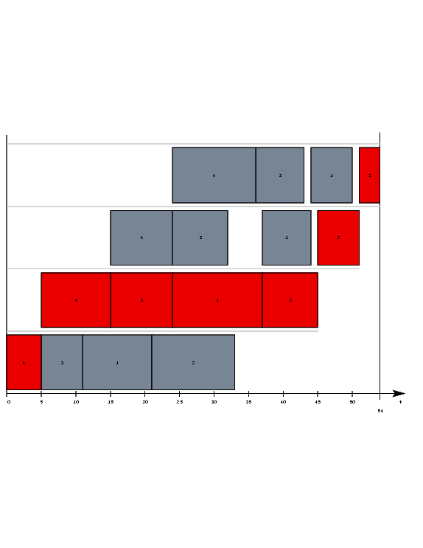
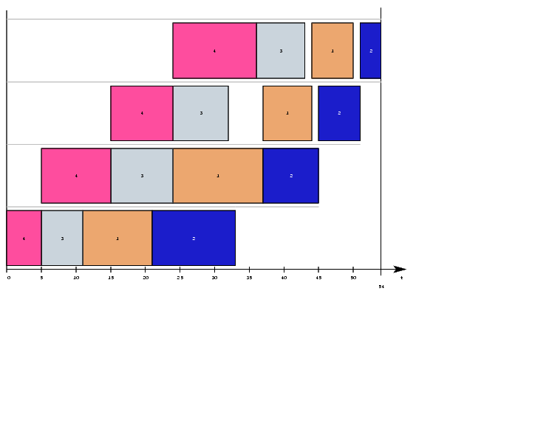
Flow Shop Scheduling Unlimited Intermediate Storage Fm l prmu l C_{max}
Gantt chart of solution S=4-3-1-2
Chart on right highlights Critical path
m4
m3
m2
m1

Slide 27
Flow Shop Scheduling Unlimited Intermediate Storage Fm l prmu l C_{max}
Mixed-integer programming formulation
Definitions:
x_{j,k} = 1, if job j in position k of sequence
I_{i,k} = idle time on machine i between jobs in positions k and k+1
W_{i,k} = waiting time of job in position k between machines i and i+1
Δ_{i,k} = I_{i,k} + p_{i,[k+1]} + W_{i,k+1} = W_{i,k} + p_{i+1,[k]} + I_{i+1,k}
= difference in starting time of position k+1 job on machine i+1 and the completion time of the position k job on machine i
Δ_{i,k}
 | p_{i,[k]} | I_{i,k} |  |  | p_{i,[k+1]} | W_{i,k+1}
 | p_{i+1,[k-1]} |  |  |  | p_{i+1,[k]} |  | p_{i+1,[k+1]}
(I_{i+1,k}=0)
W_{i,k}

Slide 28
Flow Shop Scheduling Unlimited Intermediate Storage Fm l prmu l C_{max}
Mixed-integer programming formulation
Minimize makespan minimize idle time on last machine
= time for job [1] to get to machine m +
sum of idle intervals on machine m
assignment problem
constraints
I_{i,k} + p_{i,[k+1]} + W_{i,k+1} = W_{i,k} + p_{i+1,[k]} + I_{i+1,k}

Slide 29
Flow Shop Scheduling Special Features Flow Shops
Machines have different speeds in proportionate permutation flow shop… ( p_{m,j} = p_{j} all m )
machine with min v_{k} is bottleneck (v_{k} = speed of machine k)
if first machine is bottleneck ---> LPT minimizes C_{max}
if last machine is bottleneck ---> SPT minimizes C_{max}
Flexible Flow Shop
c stages
each stage i has m_{i} identical processors
makespan heuristic: LPT (LRPT , if preemption)
sum of C_{i} heuristic: SPT , if m_{i} ≥ m_{i-1} i=2,…,c
jobs will not be blocked at next stage
SPT minimizes start time on m₁ and total processing time

Slide 30
Flow Shop Scheduling Limited Intermediate Storage Fm l nwt l C_{max}
job j | p_{1,j} | p_{2, j} |  | p_{3, j} | ……… | p_{m, j}
job k |  | p_{1,k} | p_{2,k} | I_{3,k} | p_{3,k} | ……… | p_{m,k}
“No-wait” flow shop
jobs are not blocked once they start through the shop
jobs “pulled” to next machine
push all job k times to the right
group all idle periods with respect to job j at the beginning
more restrictive --> C_{max}(nwt) C_{max}(blocking)
d_{j,k} = total delay to job k with respect to job j

Slide 31
Flow Shop Scheduling Limited Intermediate Storage Fm l nwt l C_{max}
Total delay to job k with respect to job j calculation
job j | p_{1,j} | p_{2, j} |  | p_{3, j} | ……… | p_{m, j}
job k |  | p_{1,k} | p_{2,k} | I_{3,k} | p_{3,k} | ……… | p_{m,k}
minimized using TSP
constant

Slide 32
Flow Shop Scheduling Limited Intermediate Storage Fm l nwt l C_{max}
TSP distance matrix, D
 | d_{j,k}
0 | 0 |  | 0 | ……

Slide 33
Flow Shop Scheduling Limited Intermediate Storage Fm l nwt l C_{max}
j | k |  | max=
1 | 2 | max{ 3, 7-11, 17-12 } | 5
1 | 3 | max{ 3, 7-7, 17-16 } | 3
1 | 4 | max{ 3, 7-10,17-22 } | 3
2 | 1 | max{ 11, 12-3, 17-7 } | 11
2 | 3 | max{ 11, 12-7,17-16 } | 11
2 | 4 | max{ 11, 12-10, 17-22 } | 11
3 | 1 | max{ 7, 16-3, 29-7 } | 22
3 | 2 | max{ 7, 16-11, 29-12 } | 17
3 | 4 | max{ 7, 16-10, 29-22 } | 7
4 | 1 | max{ 10, 22-3, 24-7 } | 19
4 | 2 | max{ 10, 22-11, 24-12 } | 12
4 | 3 | max{ 10, 22-7, 24-16 } | 15
No-wait example
p_{i,j} | j1 | j2 | j3 | j4
m1 | 3 | 11 | 7 | 10
m2 | 4 | 1 | 9 | 12
m3 | 10 | 5 | 13 | 2

Slide 34
Flow Shop Scheduling Limited Intermediate Storage Fm l nwt l C_{max}
Distance matrix
for example
Closest unvisited city heuristic for TSP
try all jobs in starting position
Sequence | distance
1-3-4-2 | 39*
1-4-2-3 | 55
2-1-3-4 | 45
2-1-4-3 | 58
2-3-4-1 | 54
2-4-3-1 | 65
3-4-2-1 | 47
4-2-3-1 | 62
4-2-1-3 | 55
D | j1 | j2 | j3 | j4 | Dum
j1 | …… | 5 | 3 | 3 | 17
j2 | 11 | …… | 11 | 11 | 17
j3 | 22 | 17 | …… | 7 | 29
j4 | 19 | 12 | 15 | …… | 24
Dum | 0 | 0 | 0 | 0 | ……

Slide 35
Flow Shop Scheduling Limited Intermediate Storage Fm l nwt l ΣC_{j}
Reference: C. Rajendran and D. Chaudhuri (1990), “Heuristic Algorithms for Continuous Flow Shop Problem”, Naval Research Logistics, 37 , 695-705.
Objective is to minimize the sum of the completion times of the n jobs on machine m
constant

Slide 36
Flow Shop Scheduling Limited Intermediate Storage Fm l nwt l ΣC_{j}
Heuristic approach based on job insertion
σi is preferred to σk if S_{i} S_{k}
indicates there is less “pressure” on the completions of jobs following job i vs. job k across all machines
Algorithm
Order jobs by ascending values of
ties broken by selecting job with smallest
Place first job on list in position p of partial schedule, where

Slide 37
Flow Shop Scheduling Limited Intermediate Storage Fm l nwt l ΣC_{j}
Algorithm (cont.)
For each partial schedule generated, evaluate
and choose partial schedule with minimum D_{p}
Set σ = chosen partial schedule and n’ = n’+1
Delete first job from T_{i} ordered list
If T_{i} empty --> stop, schedule completed
Else, go to step (2)

Slide 38
Flow Shop Scheduling Limited Intermediate Storage Fm l nwt l ΣC_{j}
Example: m = 4, n = 5
form ordered list from T_{i} and T_{i}’
P_{j,i} | j1 | j2 | j3 | j4 | j5
m1 | 12 | 20 | 19 | 14 | 19
m2 | 24 | 3 | 20 | 23 | 15
m3 | 12 | 19 | 3 | 16 | 17
m4 | 13 | 11 | 15 | 14 | 22
job i | 1 | 2 | 3 | 4 | 5
T_{i} | 157 | 138 | 157 | 171 | 177
T_{i}’ | 61 | 53 | 57 | 67 | 73
ordered list = 2-3-1-4-5
(T_{i}’ used to order 3-1)

Slide 39
Flow Shop Scheduling Limited Intermediate Storage Fm l nwt l ΣC_{j}
Distance matrix:
d_{j,k} | 1 | 2 | 3 | 4 | 5
1 | --- | 25 | 19 | 22 | 17
2 | 20 | --- | 20 | 20 | 20
3 | 27 | 19 | --- | 25 | 20
4 | 25 | 30 | 25 | --- | 19
5 | 25 | 31 | 31 | 20 | ---

Slide 40
Flow Shop Scheduling Limited Intermediate Storage Fm l nwt l ΣC_{j}
Algorithm
Sum of completion times
This is the optimal schedule
σ | n’ | job from list | candidate σ | D_{p} | chosen σ
Φ | 0 | 2 | 2 | --- | 2
2 | 1 | 3 | 3-2, 2-3 | 19, 20 | 3-2
3-2 | 2 | 1 | 3-1-2, 3-2-1 | 79, 58 | 3-2-1
3-2-1 | 3 | 4 | 3-4-2-1, 3-2-4-1, 3-2-1-4 | 155, 122, 119 | 3-2-1-4
3-2-1-4 | 4 | 5 | 3-2-5-1-4, 3-2-1-5-4, 3-2-1-4-5 | 208, 190, 199 | 3-2-1-5-4

Slide 41
Graph Representation of Job Shop Problem
Each job follows a specific route through the job shop ...
(1,1)
(2,1)
(3,1)
Sink
Source
(1,2)
(2,2)
(4,2)
(2,3)
(1,3)
(4,3)
(3,3)
Conjunctive arcs

Slide 42
Graph Representation of Job Shop Problem
Example of a job shop problem: 4 machines and 3 jobs
1,1
2,1
3,1
S
2,2
1,2
4,2
3,2
T
1,3
2,3
4,3
Disjunctive Graph

Slide 43
Graph Representation of Job Shop Problem
(i, j) processing of job j on machine i
p_{ij} processing time of job j on machine i
G = (N, A ∪B)
(i, j)∈N all the operations that must be performed on the n jobs
A conjunctive (solid) arcs represent the precedence relationships between the processing operations of a single job
B disjunctive (broken) arcs connect two operations which belong to two different jobs, that are to be processed on the same machine, they go in opposite directions
Disjunctive arcs form a clique for each machine.
Clique is a maximal subgraph in which all pairs of nodes are connected with each other.
Operations in the same clique have to be done on the same machine.

Slide 44
Solving the Makespan Problem
Select one of each pair of disjunctive arcs
The longest path in this graph G(D) determines the makespan
(1,1)
(2,1)
(3,1)
Sink
Source
(1,2)
(2,2)
(4,2)
(2,3)
(1,3)
(4,3)
(3,3)

Slide 45
Solving the Makespan Problem
10
8
1,1
2,1
3,1
0
4
S
0
2,2
8
1,2
3
4,2
5
3,2
6
T
0
3
1,3
4
2,3
7
4,3
Minimize makespan: find a selection of disjunctive arcs that minimizes the length of the longest path (the critical path).

Slide 46
Disjunctive Programming
Minimize
Subject to

Slide 47
Graph Representation
How to construct a feasible schedule ( A Selection )
Select D - a subset of disjunctive arcs (one from each pair) such that the resulting directed graph G(D) has no cycles.
Graph G (D) contains conjunctive arcs + D.
D represents a feasible schedule.
A cycle in the graph corresponds to a schedule that is infeasible.
Example
h,j
i,j
machine i
j
k
invalid
machine h
k
j
i,k
h,k

Slide 48
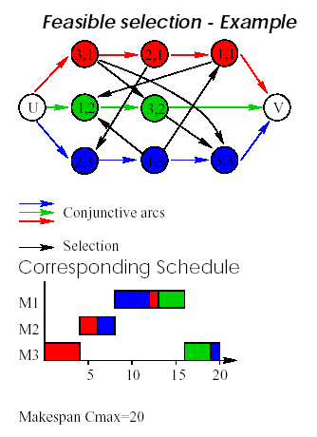
Graph Representation

Slide 49
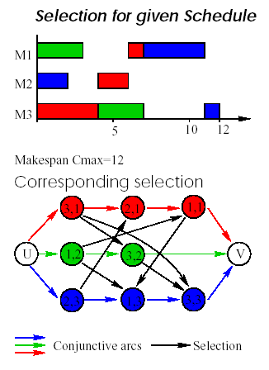
Graph Representation

Slide 50
Definitions
Job Shop Scheduling
A schedule is nondelay if no machine is idled when there is an operation available
A schedule is called active if no operation can be completed earlier by altering the sequence on machines and not delaying other operations
For “regular” objectives the optimal schedule is always active but not necessarily nondelay

Slide 51
Schedule Space
Job Shop Scheduling
Semiactive
Optimum
Nondelay
Active
All Schedules

Slide 52
Job Shop Scheduling

Slide 53
Job Shop Scheduling

Slide 54
Nonactive Schedule
Job Shop Scheduling
Machine 1
(1,1)
Machine 2
(2,3)
(2,1)
(2,2)
(2,1)
Machine 3
(3,2)
0 2 4 6 8

Slide 55
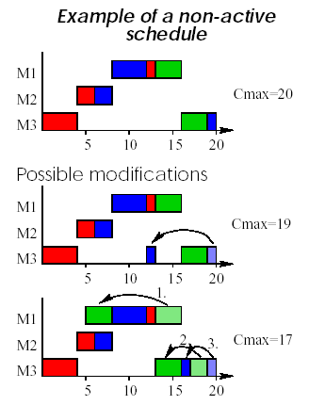
Job Shop Scheduling

Slide 56
Active Schedule, not Nondelay
Job Shop Scheduling
Machine 1
(1,1)
Machine 2
(2,3)
(2,2)
(2,1)
Machine 3
(3,2)
0 2 4 6 8

Slide 57
Nondelay schedule
Job Shop Scheduling
Machine 1
(1,1)
Machine 2
(2,3)
(2,1)
(2,2)
Machine 3
(3,2)
0 2 4 6 8

Slide 58
Branch and Bound
Job Shop Scheduling
Jm l l C_{max}
Operation (i,j) with duration p_{ij}
Minimize makespan
Branch by generating all active schedules
Notation
Let Ω denote operations whose predecessors have been scheduled
Let r_{ij} be the earliest possible starting time of (i,j) in Ω.

Slide 59
Generating Active Schedules
Job Shop Scheduling
Jm l l C_{max}
Step 1. (Initialize)
Let Ω contain the first operation of each job
Let r_{ij} = 0 for all (i,j)∈Ω.
Step 2. (Machine selection)
Compute for the current partial schedule
and let i * denote the machine where minimum achieved

Slide 60
Job Shop Scheduling
Jm l l C_{max}
Step 3. (Branching)
Let Ω’ denote all operations on machine i * such that
For each operation in Ω’ consider a partial schedule with that operation next on i *
For each partial schedule, delete operation from Ω and include immediate follower in Ω. Go back to Step 2.

Slide 61
Branching Tree
Job Shop Scheduling
Jm l l C_{max}
Selection of (i*,j)
Selection of (i*,l)
Each node in the B&B tree is characterized by a set D’ of fixed disjunctions
Add disjunctions (i*,j) --> (i*,k) for all unscheduled operations (i*,k)
Add disjunctions (i*,l) --> (i*,k) for all unscheduled operations (i*,k)

Slide 62
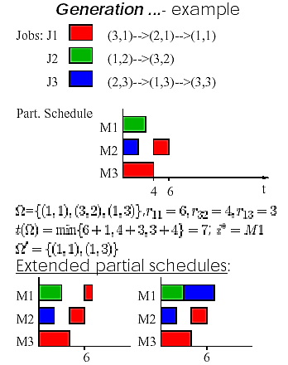
Job Shop Scheduling
Jm l l C_{max}

Slide 63
Example
Job Shop Scheduling
Jm l l C_{max}
(1,1)
10
(2,1)
8
(3,1)
4
0
Source
0
(2,2)
8
(1,2)
3
(4,2)
5
(3,2)
6
Sink
0
3
(1,3)
4
(2,3)
7
(4,3)

Slide 64
Partitioning Tree
Job Shop Scheduling
Jm l l C_{max}
Level 1
(1,1)
10
(2,1)
8
(3,1)
0
4
Source
0
(2,2)
8
(1,2)
3
(4,2)
5
(3,2)
6
Sink
0
3
(1,3)
4
(2,3)
7
(4,3)

Slide 65
Level 1: select (1,1)
Job Shop Scheduling
Jm l l C_{max}
(1,1)
10
(2,1)
8
(3,1)
10
4
0
10
Source
0
(2,2)
8
(1,2)
3
(4,2)
5
(3,2)
6
Sink
0
3
(1,3)
4
(2,3)
7
(4,3)
Disjunctive Arcs

Slide 66
Job Shop Scheduling
Jm l l C_{max}
Level 1: select (1,3)
(1,1)
10
(2,1)
8
(3,1)
4
0
4
Source
0
(2,2)
8
(1,2)
3
(4,2)
5
(3,2)
6
Sink
0
4
3
(1,3)
4
(2,3)
7
(4,3)
Disjunctive Arcs

Slide 67
Branching Tree
Job Shop Scheduling
Jm l l C_{max}
No disjunctive arcs
(1,1) scheduled first
on machine 1
LB = 24
(1,3) scheduled first
on machine 1
LB = 26

Slide 68
Branching Tree
Job Shop Scheduling
Jm l l C_{max}
Level 2:
(1,1)
10
(2,1)
8
(3,1)
0
10
4
10
3
Source
0
(2,2)
8
(1,2)
(4,2)
5
(3,2)
6
Sink
0
3
(1,3)
4
(2,3)
7
(4,3)

Slide 69
Level 2: Select (2,2)
Job Shop Scheduling
Jm l l C_{max}
(1,1)
10
(2,1)
8
(3,1)
10
4
0
10
Source
0
(2,2)
8
(1,2)
3
(4,2)
5
(3,2)
6
Sink
0
3
(1,3)
4
(2,3)
7
(4,3)
Disjunctive Arcs

Slide 70
Job Shop Scheduling
Jm l l C_{max}
Branching Tree
No disjunctive arcs
(1,1) scheduled first
on machine 1
LB = 24
(1,3) scheduled first
on machine 1
LB = 26
(1,1) first on M1 and
(2,2) first on M2
LB = 24

Slide 71
Job Shop Scheduling Shifting Bottleneck
The Shifting Bottleneck Heuristic and the Makespan
A classic idea in nonlinear programming is to hold all but one variable fixed and then optimize over that variable.
Then hold all but a different one fixed, and so on.
If we can do the one-variable optimization in order of decreasing importance, there is better hope that the local optimum found will be the global one, or close to it.
In job shop problems fixing the value of variables means fixing the sequence on a given machine.
Notes:
Idea: Heuristic Scheduling Systems, page 224

Slide 72
Shifting Bottleneck
Pick most loaded resource
Find optimal one-machine schedule
Pick next most loaded resource
Find optimal one-machine schedule consistent with previous one-machine schedules

Slide 73
Job Shop Scheduling Shifting Bottleneck Jm l l C_{max}
Shifting Bottleneck Algorithm
Step 1. Set the initial conditions
M₀ = ∅ set of scheduled machines.
Graph G is the graph with all the conjunctive arcs and no disjunctive arcs.
Set C_{max}(∅) equal to the longest path in graph G.
Step 2. Analysis of the machines still to be scheduled
formulate a single machine problem with all operations subject to release dates and due dates.

Slide 74
Job Shop Scheduling Shifting Bottleneck
Iteration
M set of m machines
M₀ ⊂ M machines for which sequence of jobs has already been determined in previous iterations
i∈{M-M₀}
p_{ij}
S
i,j
T
Define a single-machine problem 1 | r_{j} | L_{max}
for machine i

Slide 75
Job Shop Scheduling Shifting Bottleneck
Step 3. Bottleneck selection
A machine k with the largest maximum lateness is a bottleneck.
1. Schedule machine k according to the sequence which minimizes the corresponding L_{max} (single-machine problem).
2. Insert all the corresponding disjunctive arcs in the graph.
3. Insert machine k in M₀.
C_{max}(M₀ ∪ k) ≥ C_{max}(M₀) + L_{max}(k)

Slide 76
Job Shop Scheduling Shifting Bottleneck
Step 4. Resequencing of all machines scheduled earlier
Aim: to reduce the makespan
Do for each machine l∈{M₀ - k}
delete the disjunctive arcs associated with the machine l
formulate a single machine problem for the machine l and find the sequence that minimizes L_{max}(l)
Insert the corresponding disjunctive arcs.
Step 5. Go to Step 2 until M₀ = M

Slide 77
Example
Job Shop Scheduling Shifting Bottleneck
Jobs | Machines | Processing times
1 | 1,2,3 | p₁₁=10, p₂₁=8, p₃₁=4
2 | 2,1,4,3 | p₂₂=8, p₁₂=3, p₄₂=5 , p₃₂=6
3 | 1,2,4 | p₁₃=4, p₂₃=7, p₄₃=3
M1
J1
10
8
4
M2
M3
J2
8
3
5
6
M4
J3
4
7
3

Slide 78
Step 1
Job Shop Scheduling Shifting Bottleneck
(1,1)
10
(2,1)
8
(3,1)
4
0
Source
0
(2,2)
8
(1,2)
3
(4,2)
5
(3,2)
6
Sink
0
3
(1,3)
4
(2,3)
7
(4,3)

Slide 79
Step 2
Job Shop Scheduling Shifting Bottleneck
Find release date and due date of each operation
Remove all sequence constraints among activities in M – M₀, use CPM to find CP and min. start time, max. end time for each activity
Since M₀ is initially empty, we only have “conjunctive arcs”
C_{max}(M₀)
10
8
4
J1
10
8
4
8
3
5
6
J2
8
3
5
6
4
7
3
J3
4
7
3

Slide 80
Job Shop Scheduling Shifting Bottleneck
Step 2 : Find Release & Due Dates (CPM)
0
C_{max}(M₀)
22
J1
10
8
4
[0 10]
[10 18]
[18 22]
J1
10
8
4
J2
8
3
5
6
J2
8
3
5
6
[0 8]
[8 11]
[11 16]
[16 22]
J3
4
7
3
J3
4
7
3
[0 12]
[4 19]
[11 22]

Slide 81
Job Shop Scheduling Shifting Bottleneck
Step 3.
M₀ = ∅
C_{max}(∅)=22
10
8
1,1
2,1
3,1
0
4
S
0
2,2
8
1,2
3
4,2
5
3,2
6
T
0
3
1,3
4
2,3
7
4,3
Machine 1
L_{max}(1, 2, 3) = max {0, 2, 5} = 5
L_{max}(1, 3, 2) = max {0, 2, 6} = 6
L_{max}(2, 1, 3) = max {0, 11, 13} =13
L_{max}(2, 3, 1) = max {0, 3, 15} = 15
L_{max}(3, 1, 2) = max {-8, 4, 6} = 6
L_{max}(3, 2, 1) = max {-8, 0, 15} = 15
1,2,3 L_{max}=5

Slide 82
Job Shop Scheduling Shifting Bottleneck
1,1
10
2,1
8
3,1
0
4
S
0
2,2
8
1,2
3
4,2
5
3,2
6
T
0
3
1,3
4
2,3
7
4,3
Machine 2
L_{max}(1, 2, 3) = max {0, 16, 14} = 16
L_{max}(1, 3, 2) = max {0, 6, 25} = 25
L_{max}(2, 1, 3) = max {0, 0, 6} = 6
L_{max}(2, 3, 1) = max {0, -4, 5} = 5
L_{max}(3, 1, 2) = max {-8, 1, 19} = 19
L_{max}(3, 2, 1) = max {-8, 11, 9} = 11
2,3,1 L_{max}=5

Slide 83
Job Shop Scheduling Shifting Bottleneck
1,1
10
2,1
8
3,1
0
4
S
0
2,2
8
1,2
3
4,2
5
3,2
6
T
0
3
1,3
4
2,3
7
4,3
Machine 3
L_{max}(1, 2) = max {0, 6} = 6
L_{max}(2, 1) = max {0, 4} = 4
L_{max}=4

Slide 84
Job Shop Scheduling Shifting Bottleneck
1,1
10
2,1
8
3,1
0
4
S
0
2,2
8
1,2
3
4,2
5
3,2
6
T
0
3
1,3
4
2,3
7
4,3
Machine 4
L_{max}(2, 3) = max {0, -3} = 0
L_{max}(3, 2) = max {-8, 3} = 3
L_{max}=0

Slide 85
Job Shop Scheduling Shifting Bottleneck
Machines 1 and 2 are the bottlenecks
arbitrarily pick machine 1…
J1
J2
J3
10
3
4
10
3
4
L_{max}(1) = 5
M1
[0 10]
[8 11]
[0 12]
0
10
13
M2
J1
8
J2
8
J3
7
J2
J3
J1
8
7
8
L_{max}(2) = 5
[10 18]
[0 8]
[4 19]
0
8
15
M3
4
6
L_{max}(3) = 4
6
4
[18 22]
[16 22]
16
22
M4
5
3
5
3
L_{max}(4) = 0
[11 16]
[11 22]
11
16

Slide 86
Job Shop Scheduling Shifting Bottleneck
Step 2 (Iteration 2)
10
8
1,1
2,1
3,1
0
10
4
S
0
2,2
8
1,2
3
4,2
5
3,2
6
T
3
3
0
1,3
4
2,3
7
4,3

Slide 87
Step 2 (Iteration 2)
Job Shop Scheduling Shifting Bottleneck
CPM
Find C_{max}(M₀) = 27, find release & due dates
M1
10
3
4
M2
J1
8
J2
8
J3
7
J2
[10 23]
[0 10]
[17 24]
M2
8
J1
8
J3
7
M3
4
6
M3
4
6
[18 27]
[18 27]
M4
5
3
M4
5
3
[13 21]
[24 27]

Slide 88
Job Shop Scheduling Shifting Bottleneck
M₀ = {1}, C_{max}({1})=27
Selecting a Machine
10
8
1,1
2,1
3,1
0
10
4
S
0
2,2
8
1,2
3
4,2
5
3,2
6
T
3
3
0
1,3
4
2,3
7
4,3
Machine 2
2,1,3 L_{max}=1

Slide 89
Job Shop Scheduling Shifting Bottleneck
Machine 3
1,2 or 2,1 L_{max}=1
Machine 4
L_{max}=0
Machines 2 and 3 are bottlenecks.
Machine 2 is chosen as a bottleneck!

Slide 90
Job Shop Scheduling Shifting Bottleneck
10
8
1,1
2,1
3,1
0
10
4
8
8
S
0
2,2
8
1,2
3
4,2
5
3,2
6
T
3
3
0
1,3
4
2,3
7
4,3
C_{max}({1,2}) = C_{max}({1}) + L_{max}(2) = 27 + 1 = 28
Can we decrease C_{max}({1,2}) ?
Will resequencing machine 1 give any improvement ?

Slide 91
Job Shop Scheduling Shifting Bottleneck
1,1
10
2,1
8
3,1
×
0
10
4
8
8
S
0
2,2
8
1,2
3
4,2
5
3,2
6
T
×
3
3
0
Machine 1
1,3
4
2,3
7
4,3
C_{max}({1,2}) = 28
L_{max}(1, 2, 3) = max {0, -4, -1} = 0
L_{max}(1, 3, 2) = max {0, -4, 0} = 0
L_{max}(2, 1, 3) = max {-6, 11,7} =11
L_{max}(2, 3, 1) = max {-6, -3, 15} = 15
L_{max}(3, 1, 2) = max {-14, 4, 0} = 4
L_{max}(3, 2, 1) = max {-14, 2, 15} = 15
original sequence: 1,2,3
Resequencing machine 1 does not give any improvement.

Slide 92
Job Shop Scheduling Shifting Bottleneck
Step 2 (Iteration 3)
CPM
Find C_{max}(M₀) = 28, find release & due dates
M1
10
3
4
M2
J2
8
J1
8
J3
7
M3
4
6
M3
4
6
[18 28]
[18 28]
M4
5
3
M4
5
3
[13 22]
[25 28]

Slide 93
Job Shop Scheduling Shifting Bottleneck
Step 3.
M₀ = {1,2}
C_{max}({1,2})=28
M3
4
6
[18 28]
[18 28]
M4
5
3
[13 22]
[25 28]
Machine 3
1,2 or 2,1 L_{max} = 0
Machine 4
L_{max} = 0
No machine is a bottleneck!

Slide 94
Job Shop Scheduling Shifting Bottleneck
Solution Graph
10
8
1,1
2,1
3,1
0
10
4
8
8
S
0
2,2
8
1,2
3
4,2
5
3,2
6
T
3
3
0
1,3
4
2,3
7
4,3

Slide 95
Job Shop Scheduling Shifting Bottleneck
Solution Gantt Chart
Machine 1
1 2 3
Machine 2
2
1 3
Machine 3
2 1
Machine 4
2
3
5
10
15
20
25
30
t

Slide 96
Solving the Maximum Lateness Problem
Job Shop Scheduling Shifting Bottleneck Jm l l C_{max}
(•,•,•)
(1,•,•)
(2,•,•)
(3,•,•)
(1,2,3)
(1,3,2)
(3,1,2)
(3,2,1)

Slide 97
Job Shop Scheduling Shifting Bottleneck Jm l l C_{max}
*,*,*,*
Branch and Bound
1st level
2nd level
1,*,*,*
2,*,*,*
n,*,*,*
. . .
1,2,*,*
1,3,*,*
. . .
Branching rule:
k-1 level, j₁, ... , j_{k-1} are scheduled,
j_{k} needs to be considered if no job still to be scheduled can not be processed before the release time of j_{k}
that is:
. . .
J set of jobs not yet scheduled
t is time when j_{k-1} is completed

Slide 98
Relaxing the Problem
Job Shop Scheduling Shifting Bottleneck Jm l l C_{max}
The problem
is a relaxation to the problem
Not allowing preemption is a constraint in the original problem but not the relaxed problem
We know how to solve the relaxed problem (preemptive EDD rule)

Slide 99
Job Shop Scheduling Shifting Bottleneck Jm l l C_{max}
Lower bound:
Preemptive earliest due date (EDD) rule is optimal for 1 | r_{j} , prmp | L_{max}
A preemptive schedule will have a maximum lateness not greater than a non-preemptive schedule.
If a preemptive EDD rule gives a non-preemptive schedule then all nodes with a larger lower bound can be disregarded.

Slide 100
Job Shop Scheduling Shifting Bottleneck Jm l l C_{max}
The solution is actually a little bit more complicated than before
Precedence constraints exist because of other (already scheduled) machines
Delay precedence constraints need to be added, if required

Slide 101
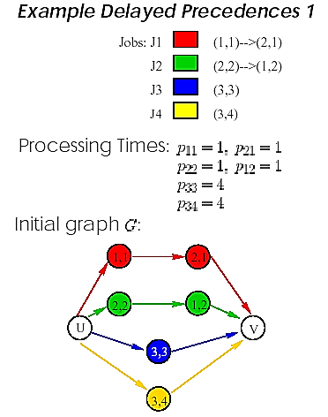
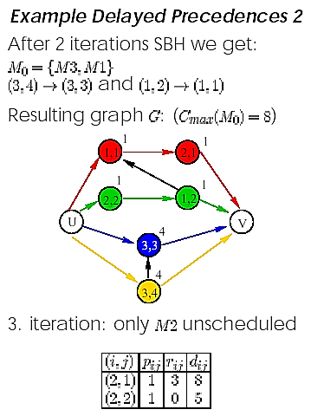
Shifting Bottleneck
Jm l l C_{max}

Slide 102
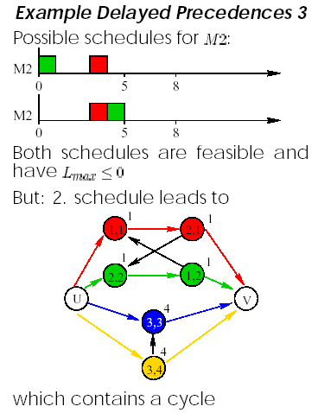
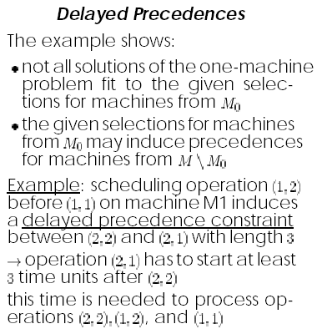
Job Shop Scheduling Shifting Bottleneck Jm l l C_{max}

Slide 103
Total Weighted Tardiness
Job Shop Scheduling Shifting Bottleneck Jm l l Σw_{j}T_{j}
Need n sinks in disjunctive graph
Machines scheduled one at a time
Given current graph calculate completion time of each job
Assess n due dates for each operation
Piecewise linear penalty function

Slide 104
Machine Selection
Job Shop Scheduling Shifting Bottleneck Jm l l Σw_{j}T_{j}
Machine criticality
Solve a single machine problem
May have delayed precedence constraints
Generalizes single-machine with n jobs, precedence constraints, and total weighted tardiness objective
Apparent Tardiness Cost (ATC) Dispatching Rule

Slide 105
Apparent Tardiness Cost (ATC) Dispatching Rule
Job Shop Scheduling Shifting Bottleneck Jm l l Σw_{j}T_{j}
Dynamic ranking index
When machine becomes free:
Compute index for all remaining jobs that are currently waiting
Select job with highest value
Scaling constant
average p_{j} of the remaining jobs
(rounded down)

Slide 106
Choosing K
Job Shop Scheduling Shifting Bottleneck Jm l l Σw_{j}T_{j}
Value of K determined empirically
Related to the due date tightness factor
and the due date range factor
Usually 1.5 ≤ K ≤ 4.5
Rules of thumb:
Fix K=2 for single machine or flow shop.
Fix K=3 for dynamic job shops.

Slide 107
Job Shop Scheduling Shifting Bottleneck Jm l l Σw_{j}T_{j}
Apparent Tardiness Cost with Setups (ATCS)
k₁=due date scaling par.
k₂=setup time scaling par.
k₁ and k₂ functions of:
Due Date tightness
Due Date Range
Setup Time Severity

Slide 108
Generalized ATC Rule
Job Shop Scheduling Shifting Bottleneck Jm l l Σw_{j}T_{j}
Ranks jobs
by impact on
all n due dates

Slide 109
Criticality of Machines
Job Shop Scheduling Shifting Bottleneck Jm l l Σw_{j}T_{j}
Criticality = subproblem m objective function
More effective ways, e.g.
Add disjunctive arcs for each machine
Calculate new completion times C_{k}’’ and

Slide 110
Example
Job Shop Scheduling Shifting Bottleneck Jm l l Σw_{j}T_{j}
(1,1)
5
(2,1)
10
(3,1)
4
Sink
5
Source
0
(3,2)
4
(1,2)
5
(2,2)
6
Sink
0
(3,3)
5
(2,3)
3
(1,3)
7
Sink
w₁=1 , w₂=2 , w₃=2

Slide 111
Subproblem: Machine 1
Job Shop Scheduling Shifting Bottleneck Jm l l Σw_{j}T_{j}

Slide 112
Job Shop Scheduling Shifting Bottleneck Jm l l Σw_{j}T_{j}
Subproblem: Machine 2

Slide 113
Job Shop Scheduling Shifting Bottleneck Jm l l Σw_{j}T_{j}
Subproblem: Machine 3

Slide 114
Job Shop Scheduling Shifting Bottleneck Jm l l Σw_{j}T_{j}
Solve using dispatching rule
Use K=0.1
Have t = 4,
For machine 1 this results in
Schedule
first

Slide 115
Job Shop Scheduling Shifting Bottleneck Jm l l Σw_{j}T_{j}
Schedule
first
Subproblem Solutions

Slide 116
Job Shop Scheduling Shifting Bottleneck Jm l l Σw_{j}T_{j}
4
(1,1)
5
(2,1)
10
(3,1)
4
Sink
5
5
10
Source
0
(3,2)
4
(1,2)
5
(2,2)
6
Sink
3
5
0
(3,3)
5
(2,3)
3
(1,3)
7
Sink
 | m₁ | m₂ | m₃
j₁ | 10 | 20 | 24
j₂ | 15 | 26 | 9
j₃ | 22 | 8 | 5
C_{m,j} using forward pass of CPM

Slide 117
Job Shop Scheduling Shifting Bottleneck Jm l l Σw_{j}T_{j}
Machine Criticality, wT(m)

Slide 118
Job Shop Scheduling Shifting Bottleneck Jm l l Σw_{j}T_{j}
First Iteration
(1,1)
5
(2,1)
10
(3,1)
4
Sink
5
5
Source
0
(3,2)
4
(1,2)
5
(2,2)
6
Sink
5
0
(3,3)
5
(2,3)
3
(1,3)
7
Sink

Slide 119
Job Shop Scheduling Shifting Bottleneck Jm l l Σw_{j}T_{j}
Subproblem: Machine 2

Slide 120
Job Shop Scheduling Shifting Bottleneck Jm l l Σw_{j}T_{j}
Subproblem: Machine 3

Slide 121
Job Shop Scheduling Shifting Bottleneck Jm l l Σw_{j}T_{j}
Schedule
first
Subproblem Solutions

Slide 122
Job Shop Scheduling Shifting Bottleneck Jm l l Σw_{j}T_{j}
Second Iteration
(1,1)
5
(2,1)
10
(3,1)
4
Sink
5
5
10
Source
0
(3,2)
4
(1,2)
5
(2,2)
6
Sink
5
3
0
(3,3)
5
(2,3)
3
(1,3)
7
Sink

Slide 123
Job Shop Scheduling Shifting Bottleneck Jm l l Σw_{j}T_{j}
Subproblem: Machine 3

Slide 124
Job Shop Scheduling Shifting Bottleneck Jm l l Σw_{j}T_{j}
Third Iteration
(1,1)
5
(2,1)
10
(3,1)
4
Sink
5
5
10
4
Source
0
(3,2)
4
(1,2)
5
(2,2)
6
Sink
5
5
3
0
(3,3)
5
(2,3)
3
(1,3)
7
Sink

Slide 125
Final Schedule
Job Shop Scheduling Shifting Bottleneck Jm l l Σw_{j}T_{j}
Machine 1
1,1
1,2
1,3
Machine 2
2,3
2,1
2,2
Machine 3
3,3
3,2
3,1
0 5 10 15 20 25 30

Slide 126
Performance
Job Shop Scheduling Shifting Bottleneck Jm l l Σw_{j}T_{j}
Objective function
A better schedule can be found using LEKIN
(optimal value = 18)
Reoptimization skipped in example… would have improved solution

